Slide 1
Part 3: Knowledge Modeling – Semantic Web

Slide 2
Implicit vs. Explicit Knowledge
Information retrieval and data mining aim at extracting and using knowledge that is implicitly represented in documents
Alternatively, knowledge can, and is, also explicitly represented

Slide 3
Overview
Semantic Web
Knowledge Extraction
Knowledge Inference

Slide 4
Semantic Web
Semi-structured data
Semantic Web
RDF - Resource Description Framework
Semantic Web Resources

Slide 5
1. Semi-structured Data

Slide 6
Database Schemas
Schemas define data structures for databases
Relational database schemas, XML Schemas
Agreement on data structures
Well understood meaning of data values
Data consistency, e.g., integrity constraints
Optimizing query evaluation and data storage
e.g. indexing, query optimization
STUDENTID | NAME | COURSE
1234 | John | DIS
3456 | Bob | physics
2345 | Ann | DIS
Schema
Notes:
Schemas in database management systems play two important roles. On the one hand they define a priori data structures that capture that application semantics. In particular they label data values with names (e.g. attribute names) that have well-understood semantics. By defining fixed data structures and additionally imposing integrity constraints they additionally assure that data stored in the database remains structurally and semantically coherent. Exploiting knowledge on data structures also enables query and storage optimizations.
However, in many information processing settings, e.g., on the Web, schema information is not always readily available, and imposing the use of schema might be too rigid and turn into a disadvantage.

Slide 7


Data on the Web
Example: Searching biological data
Based on textual content of Web pages (e.g. Google)
Searching for data on "anglerfish"
Results will be precise
This seems easy, but the same for "leech"
Organism leech
Software: LeechFTP
Rock band: Leech
Authors: Leech
Protein sequences: …MNTSLEECHMPKGD…
Search for "257" …
Notes:
In the typical Web setting no schema information is being used. When searching for information content-oriented queries are used, e.g., by providing keywords. This may work well for very specific search terms, such as illustrated for the example “anglerfish”, but might become problematic, when the search term has an ambiguous meaning, as illustrated for the example “leech”. The problem is that when the type of the information that is searched is not specified (in the case of the example the type would be “Organism”), the search algorithm cannot disambiguate the different potential meanings of the search term. If we consider the search term as a data value, this would correspond to the case where we consider a data value in a relational database without knowing it’s type and attribute name. For purely data-oriented searches, such as for a numerical value the problem becomes even more evident. Thus it appears for some cases having a data schema available, would seem also helpful for searches in the Web.

Slide 8
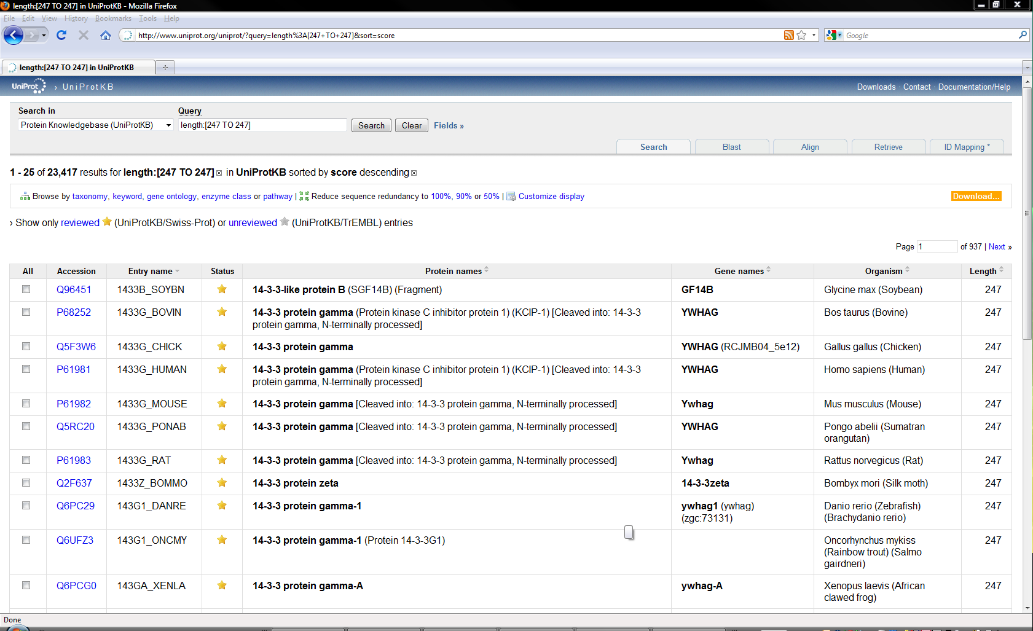
Using HTML to Structure Data
<tr>
<td style="width:0%"><input onclick="addOrAppendCart('Q96451')" class="cart-item" id="Q96451" type="checkbox"/></td>
<td style=""><a href="./Q96451">Q96451</a></td><td style="">1433B_SOYBN</td>
<td style="text-align:center;"><img src="../images/reviewed.gif" alt="" title="UniProtKB/Swiss-Prot = reviewed" /></td>
<td style=""><strong>14-3-3-like protein B</strong> (SGF14B) (Fragment)</td>
<td style=""><strong>GF14B</strong><br /></td><td style="">Glycine max (Soybean)</td>
<td style="text-align:right;white-space: nowrap;">247</td>
</tr>
<tr>
<td style="width:0%"><input onclick="addOrAppendCart('P68252')" class="cart-item" id="P68252" type="checkbox"/></td>
<td style=""><a href="./P68252">P68252</a></td>
<td style="">1433G_BOVIN</td><td style="text-align:center;"><img src="../images/reviewed.gif" alt="" title="UniProtKB/Swiss-Prot = reviewed" /></td>
<td style=""><strong>14-3-3 protein gamma</strong> (Protein kinase C inhibitor protein 1) (KCIP-1) [Cleaved into: 14-3-3 protein gamma, N-terminally processed]</td>
<td style=""><strong>YWHAG</strong><br /></td><td style="">Bos taurus (Bovine)</td><td style="text-align:right;white-space: nowrap;">247</td>
</tr>
<tr>
<td style="width:0%"><input onclick="addOrAppendCart('Q5F3W6')" class="cart-item" id="Q5F3W6" type="checkbox"/></td>
<td style=""><a href="./Q5F3W6">Q5F3W6</a></td><td style="">1433G_CHICK</td>
<td style="text-align:center;"><img src="../images/reviewed.gif" alt="" title="UniProtKB/Swiss-Prot = reviewed" /></td>
<td style=""><strong>14-3-3 protein gamma</strong></td><td style=""><strong>YWHAG</strong> (RCJMB04_5e12)<br /></td>
td style="">Gallus gallus (Chicken)</td><td style="text-align:right;white-space: nowrap;">247</td>
</tr>
HTML table layout to structure the data!?
Notes:
A typical approach to handle data in the Web is to used structured layouts, e.g. using HTML tables. In this way a context is provided, that allows to correctly interpret data values. When inspecting the source code of a typical HTML-based page with structured data, we recognize however that it might become difficult to automatically process such a page and correctly interpret the data contained in it. Such processing might be very involved and error-prone, even more so that in the context of editing Web page layout no mechanisms assure that the intended page structure is correctly implemented. The problem is that a layout language, such as HTML, never has been conceived to specify semantics of data.

Slide 9

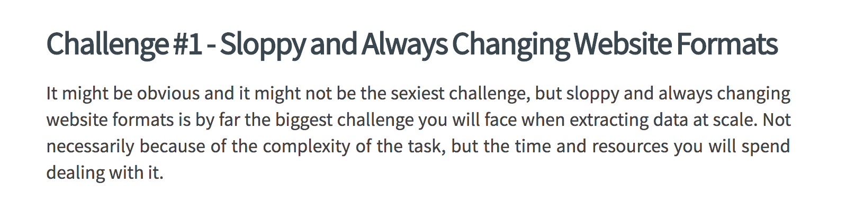
Web Scraping
Encoding data semantics through layout is a bad idea
Generations of “Web scrapers” experience this
https://www.zyte.com/blog/price-intelligence-web-scraping-at-scale-100-billion-products/

Slide 10
Application-specific Markup
Limitations of HTML
Structure of data expressed as layout: <tr><td> leech </td><tr>
Semantics of data hard to analyse and difficult to share
No schemas, no constraints
Making the meaning of data explicit
SwissProt: <Species> leech </Species>
EMBLChange: <Organism> leech </Organism>
Embedding of schema information into the data
Application-specific markup (tags)
Notes:
Therefore an alternative approach for specifying the meaning of data contained in documents, in particular in Web documents, has been conceived. As for HTML it is based on the idea of using tags, i.e. markup that associates to parts of a document a name. However, instead of using tags to provide layout instructions (e.g. a table format), tags are used to provide domain-specific meaning to data contained in a document. For example, markup can be used to specify that a specific name (such as leech) denotes an organism. This approach is of course well known and widely used. For example, email formats contain different standard markups to indicate the different parts of a mail. In the Web this approach has found wide-spread adoption through the XML format. XML generalizes the markup approach from HTML to allow applications to specify their application-specific tags and to embed them into documents.
Exercise: refresh your knowledge on XML and schemas in XML.

Slide 11
Semi-structured Data
Data that embeds schema information (through tags, markup etc.) to explain the meaning of data values and to relate different data values (e.g. hierarchically) = semi-structured data
No predefined data structure, no schema required!
Examples of semi-structured data
Email
Microformats (e.g. hCard)
JSON
XML (Extensible Markup Language)
Notes:
Data that contains embedded schema information, such as tags or markup, is generally called semi-structured data. Semi-structured data allows to indicate the meaning of data values, as in structured data with schemas, without requiring predefined schemas. This combines flexibility with the ability to capture meaning. The fact that semi-structured data does not require schemas, does not imply that we cannot define schemas for semi-structured data. XML is an example of this. We can have XML structured documents without schema, so-called well-formed XML documents, but define in addition schemas for XML (document type definitions, so-called XML DTDs). Documents that follow such a schema are then called valid XML documents.

Slide 12
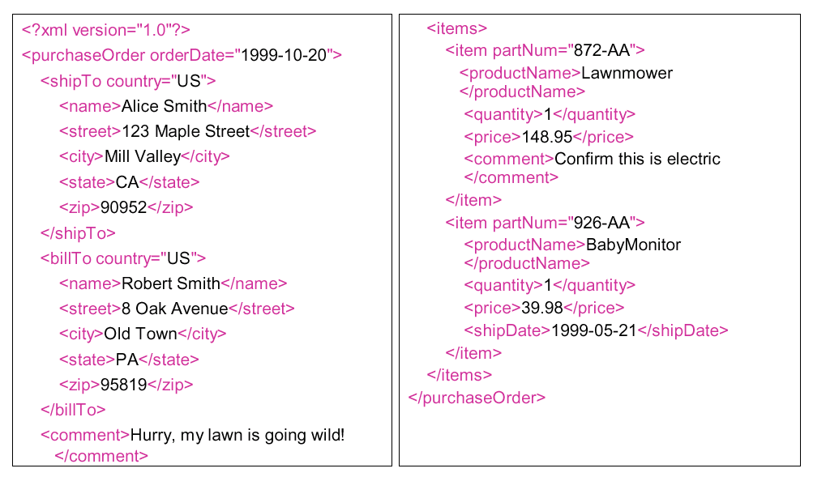
XML – a Document Markup Language
Notes:
Originally XML has been conceived as a document model. In this example of an XML document we can clearly see the document nature of XML. An XML document consists of hierarchically nested tags which enclose textual content.

Slide 13
XML- a Semi-structured Data Model
2002-13-12
orderDate
purchaseOrder
shipTo
billTo
comment
items
Hurry …
name
street
city
state
zip
124-AA
item
item
partNum
partNum
productName
quantity
price
comment
AliceSmith
Mill Valley
CA
90952
123 Maple Street
Lawnmower
1
152,99
confirm order
Notes:
However, the same XML document can also be viewed as structured data. An XML parser would typically generate a hierarchical data structure as illustrated. This explains why we can understand XML also as a data model, more precisely a semi-structure data model, as it embeds schema information into the data.

Slide 14
Schema-less data
Benefits of schema-less data
Increased flexibility
e.g. dynamically adding or dropping structural elements such as attributes
Self-contained data
e.g. context (schema information) directly encoded into data (markup)
Drawbacks
Loss of consistency
Certain optimizations not feasible
Notes:
Semi-structured data can be schema-less. This has significant advantages for applications that do not know the structural elements in advance. For example, often it is helpful if new types of attributes can be added in a database as application requirements evolve. Another advantage is that by embedding schema information into the data, data can be interpreted without requiring additional context information in the form of database schemas. This can be useful in applications where data is exchanged, as illustrated before for the case of XML.
Having no schema has however also its drawbacks as, the additional flexibility also my be at the detriment of data consistency. Applications might, for example, not be able to properly process attributes that have been arbitrarily added. Also many optimizations that rely on the availability of a schema, and on the assumption that the schema is stable, can not be applied.

Slide 15

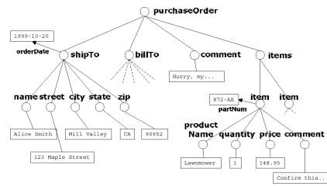
Serialization: Data and Documents
Document = medium for
exchange of information
Communication
Information system 1
Information system 2
Notes:
The duality of XML, being a document model and a data model at the same time makes it particularly suitable for applications that have to exchange data over communication networks. For every data collection or database that is represented in XML there exists a canonical encoding into a text (document). The encoding is called serialization. Since documents are sequences of symbols they can be naturally exchanged over communication networks.

Slide 16
Semi-structured data …
is always schema-less
always embeds schema information into the data
must always be hierarchically structured
can never be indexed

Slide 17
Why is XML a document model?
It supports application-specific markup
It supports domain-specific schemas
It has a serialized representation
It uses HTML tags

Slide 18
Serialised vs. Semi-structured Data
Many of the popular semi-structured data models have a serialized format (XML) or have been conceived to serialise data (JSON)
However, there exist semi-structured data models that are not based on a serialized representation
→ knowledge graphs

Slide 19
2. Semantic Web

Slide 20

The Semantic Web
User-defined markup (schemas): provides possibility to share interpretation of data across various applications
Different databases – Different schemas
SwissProt: Find <Species> leech </Species>
EMBLChange: Find <Organism> leech </Organism>
Problem: Semantic Heterogeneity → Semantic Web
Information System 2
Data 2
Interpretation 2
Information System 1
Data 1
Interpretation 1
Notes:
XML provides a framework to encode data on the Web in a standardized fashion, to deal with irregular Web data structures and to exchange Web data among information systems. Thus it contributes in particular to overcoming syntactic heterogeneity on the Web.
The markup used in XML can be interpreted by applications. This enables automatic processing of Web data. However, for properly interpreting the markup, semantic heterogeneity needs to be overcome as well. The same concepts can (and will be) represented in different application contexts differently, e.g., by using different terms to denote the same meaning. This is a major obstacle to enable interoperability on the Web and indeed in industry this is considered as one of the major problems in the use of information technology.
Cost of semantic integration in 2010: 1 Trillion$ / year (Mike Brodie, GTE)

Slide 21
The Vision of W3C: Semantic Web
The Semantic Web is an extension of the current Web in which information is given well-defined meaning, better enabling computers and people to work in cooperation. The mix of content on the Web has been shifting from exclusively human-oriented content to more and more data content. The Semantic Web brings to the Web the idea of having data defined and linked in a way that it can be used for more effective discovery, automation, integration, and reuse across various applications. For the Web to reach its full potential, it must evolve into a Semantic Web, providing a universally accessible platform that allows data to be shared and processed by automated tools as well as by people. The Semantic Web is an initiative of the World Wide Web Consortium (W3C), with the goal of extending the current Web to facilitate Web automation, universally accessible content, and the 'Web of Trust'.
(http://www.w3.org/2001/sw/Activity)
Notes:
In order to address the problem of semantic interoperability and thus enable automated processing of Web data, the W3C initiated the “Semantic Web” initiative. The Semantic Web is a framework that builds on Web technology, including the XML framework and extends it with technologies that facilitate semantic interoperability.

Slide 22
Three Ways to Overcome Semantic Heterogeneity
Standardization: agree on common user-defined markup (schemas)
great if no pre-existing applications
great if power player enforces it
Translation: create mappings among different schemas and databases
requires human interpretation and reasoning
mappings can be difficult, expensive to establish
Annotation: create relationships to agreed upon conceptualizations
requires human interpretation and reasoning
annotation can be difficult, expensive to establish
reasoning over the conceptualization can provide added value
Notes:
There exist three basic approaches to tackle the problem of automating semantic processing of the data on the Web:
Standardization avoids the problem of semantic heterogeneity a priori. This approach is used when there exists already (historically) a wide agreement on the structure of relevant data and their interpretation. For example, terminology in the financial industry is largely standardized, and therefore it is not a major problem to come up with agreed upon formal specifications of such terminology and corresponding schemas to represent the data. This is even more the case as there exist in this type of business environment typically strong players that can enforce the standards.
Translation or mapping between different schemas and databases is the second possibility to establish semantic interoperability. This is the approach that has been extensively studied for data integration problems in relatively small and controlled domains, such as inside businesses and organizations. The requirements in these domains are typically changing not too quickly, thus much effort can be invested into developing the necessary mappings in order to properly map data from one representation into another, or to map data from multiple representations into one common global representation.
The third possibility is slightly different from the second: instead of engineering mappings between heterogeneous schemas for each integration problem, one first agrees on a common conceptualization of the domain, covering relevant aspects for a large class of applications. This conceptualization is normally called an ontology and is supposed to be application independent. Since ontologies have a formal representation they are machine-processable. Once such an ontology is in place existing information sources can relate their structural elements for expressing certain concepts (e.g. element names) to concepts from the ontology. This then (ideally) enables other applications to properly interpret the contents of the information system. In addition, ontologies in the general case should include reasoning capabilities, which would permit to use not only hard-coded, or pre-canned knowledge (e.g. in form of explicitly relating concepts from an information system to the ontology), but also to derive new knowledge from combining existing knowledge in different ways such that new implied relations can be derived that have not been explicitly provided.

Slide 23
Mapping: Three Approaches
1. Standardization
Mapping through standards
2. Mapping
Direct mapping
3. Ontologies
Mediated mapping
EDIFACT
EDIFACT
FIBO
Notes:
Conceptually there exists three main possibilities of how to address semantic heterogeneity. A first approach is to map all the models everything to one common global model. This approach is taken with standardization. For example, EDIFACT (https://www.unece.org/cefact/edifact/) is an international standard that models all concepts that are commonly used in business and trade. For exchanging information systems used in that domain map their data to EDIFACT and can thus exchange their information. A second approach, is to relate the model of an information system to a common model, frequently called ontology, and use this mapping to construct a direct mapping among the different models used in the information systems. A third approach consists of trying to construct directly a mapping among two information systems, without having any additional, shared knowledge in form of standards or ontologies among the two information systems. For example, in the financial domain there exists a standard reference ontology called FIBO (https://fib-dm.com/finance-ontology-transform-data-model/)

Slide 24
Direct Schema Mapping
Assume all data represented in canonical data model (e.g. relational)
detect correspondences (schema matching)
resolve conflicts
integrate schemas (schema mapping)
Mappings are frequently expressed as queries (e.g. SQL Query)
Notes:
Creating direct mappings among information systems has been intensively explored for mapping data that is stored in relational and XML databases, and where the model is represented as a database schema. The problem is known as the schema mapping problem. Given two schemas of databases, first schema elements are identified that are likely to correspond to each other, i.e. that are likely representing the same real world aspect. This can be done by using many types of analysis using structural and content features of the database schema and the database. Tools for supporting these steps are called schema mapping tools. Once this step is performed some conflicting correspondences may occur, e.g. mapping the some concept in one schema to two different ones in the other. These not to be resolved, typically through decisions taken by humans. Once the correspondences are consistent, mappings can be automatically derived. The mappings are typically expressed as queries of the data manipulation language.

Slide 25
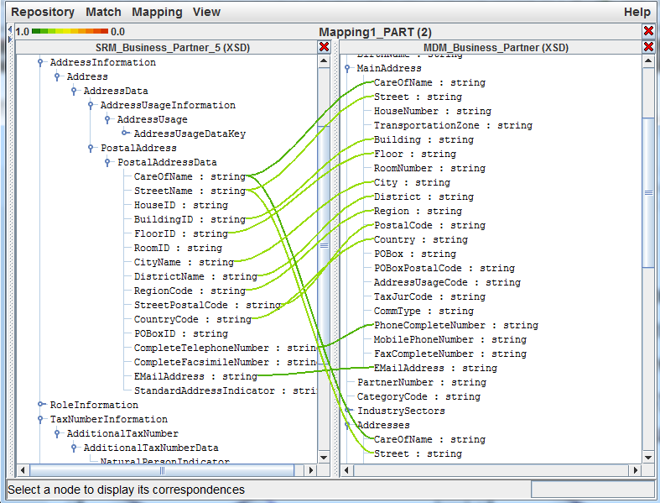
Schema Matching Tools
Notes:
This screenshot show a schema matching tool that maps between different XML schemas. The lines indicate which attributes might be related to each other. One can easily see a lot of conflicts where the same attribute corresponds to multiple attributes in another schema.

Slide 26
Mediated Mappings
MetaData (Shared Ontologies)
Organism
ISA
Fish
is-instance-of
Annotator 1
is-instance-of
Annotator 2
http://www.bio.com/SP.xml:
<SP_entry>
<ID>CBPH_LOPAM</ID>
<Authors>Roth</Authors>
<Organism>
Lophius americanus (American goosefish) (Anglerfish).
</Organism>
<Sequence>
MKQICSIVLL …
</Sequence>
</SP_entry>
http://www.bio.com/EC.xml:
<EC_entry>
<ID>
LAJAFGI_5; VRT
</ID>
<Species>
Lophius americanus (anglerfish)
</Species>
<SQ>
Sequence 1 BP
</SQ>
</EC_entry>
Data 1
Data 2
Notes:
This differentiation among different approaches to semantic interoperability can be nowadays found in standardization documents: according to ISO 14258 (Concepts and rules for enterprise models), there are three basic ways to relate entities together:
Integrated approach. There exists a common format for all models. This format must be as detailed as the models themselves. The common format is not necessarily a standard but must be agreed upon by all parties in order to elaborate models and build systems. (-> Standardization)
Federated approach. There is no common format. In order to establish interoperability parties must accommodate on the fly. Federated approach implies that no partner imposes their models, languages and methods of work. This means they must share a common ontology. (-> Translation)
Unified approach. There exists a common format but only at a meta-level. This meta-model is not an executable entity as in the case of the integrated approach but provides a way for semantic equivalence to allow mapping between models. (-> Annotation)
This simple example illustrates of how ontologies might help to increase semantic interoperability and how new knowledge may be generated by reasoning. Take our earlier example of biological databases. These typically use different schemas to model related facts. For example, Database 1 uses the term Organism to denote an organism, and database 2 uses the term Species to do the same. Two annotators, who share the same ontology, now inspect the document and each of them associates the elements with terms taken from the ontology. So Annotator 1 decides that the element Organism corresponds to information related to an organism, whereas annotator 2 recognizes actually from the content that the element is related to information about a fish and annotates correspondingly (by establishing a is-instance-of relationship). At this point, the fact that both annotators used the same ontology and that reasoning is possible in this ontology comes into play. Since in the ontology a Fish is a subconcept of Organism (a fact represented formally by a ISA relationship in the ontology) an automated processing tool (e.g. for searching for information) might exploit this relationship and correctly identify for a request for information on Organisms in both databases the related elements.

Slide 27
Ontologies
Ontologies are an explicit specification of a conceptualization of the real world (Gruber, 1993)
Ideally
different information systems agree on the same ontology
relate their model/schema/data elements to the ontology
mapping can be constructed via the ontology
Requires agreement on the conceptualization of the real world!
Information System 2
Ontology
Data 2
Interpretation 2
Information System 1
conceptualization
Data 1
Interpretation 1
Notes:
Thus ontologies provide a “proxy representation” for the real world, to which the interpretation of data in information systems refers to and thus provide an interpretation of the data in an information system that can be automatically processed. In order to realize this vision a number of technical challenges need to be addressed.

Slide 28
Creating Ontologies
Different approaches to create ontologies
Ontology engineering
Manual effort
Tools for editing and checking consistency
Automatic generation of ontologies
From large document collections or existing structured data sources
Notes:
Ontologies need to be built: this requires an agreement on the meaning of terms (symbols). In practice, there exists no other way to establish such an agreement than by extensively collecting knowledge (from humans) and represent it within a formal specification. This has been done in practice and as a result there exist extensive ontologies, some of them have been built up over many years. In the recent years, also approaches to construct ontologies automatically from existing data sources, either knowledge bases or large document collections, have been developed.

Slide 29
Modeling and Encoding of Ontologies
Issues
Modeling primitives and their semantics
what does an arrow mean?
what does "instance-of" mean?
what does ISA mean?
Standardized encodings of the model
Into document language (XML, HTML)
Enriching document content with semantic markup
Notes:
Ontologies need to be represented in a language or data model: in order to store the ontology a representation mechanism (a model) is needed, and the model needs to be encoded into data. The choice of the model is an important issue, since it should be very expressive (as a wide variety of aspects of the real world need to be modeled) and easy to use (as ontologies should be used in a wide range of applications) at the same time. The encoding is equally important, as it should be done in a standardized form. If this were not the case we would immediately loose the advantage of having a common conceptualization of the world at the abstract level, since we were not able to exchange it properly with others.

Slide 30
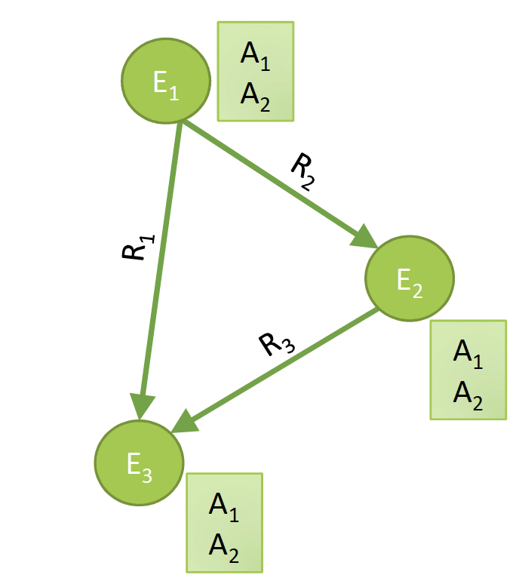
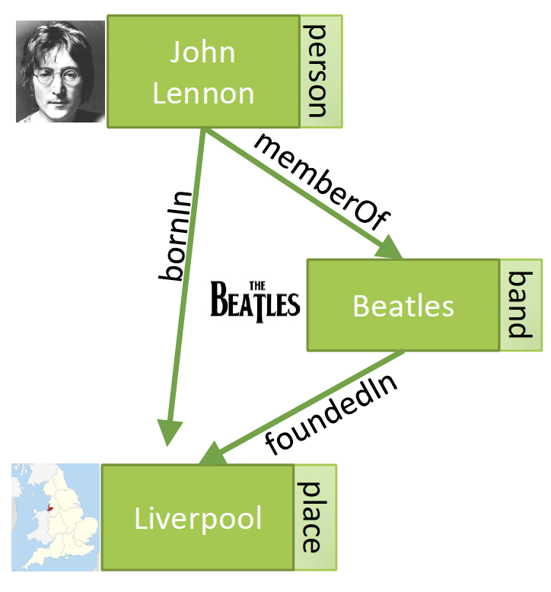
Knowledge Graphs (Google 2012)

Slide 31
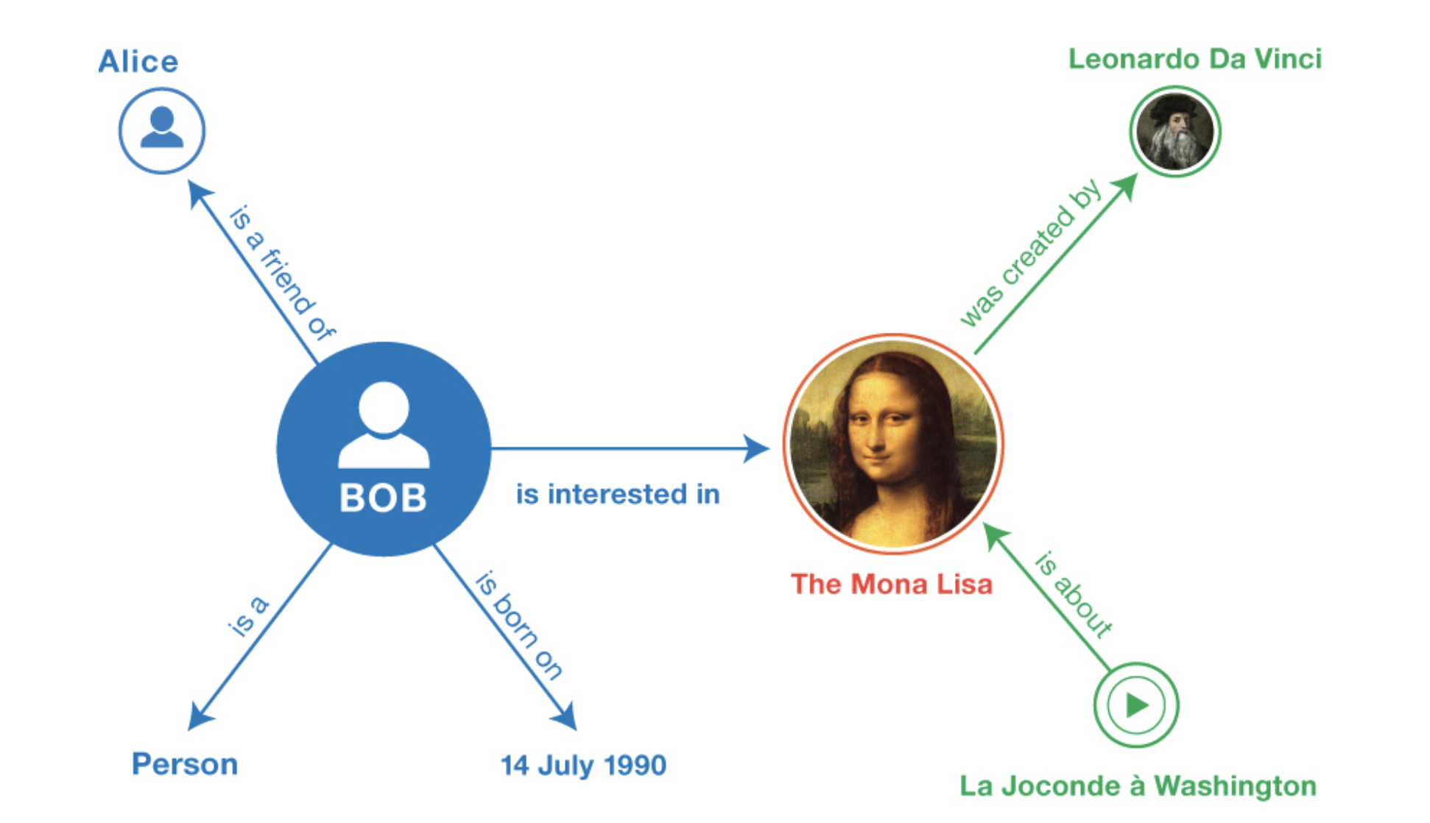
RDF – Resource Description Framework (W3C 2004)

Slide 32
Entity-Relationship Model
The Entity Relationship Model: Toward a Unified View of Data, Peter Pin-Shan Chen, 1976

Slide 33
Model Requirements for Ontologies
 | HTML | XML | RDF | OWL
Simplicity | + | + | + | +
Exchangeability | + | + | + | +
Non-intrusive annotation | + | - | + | +
Domain-specific vocabularies | - | + | + | +
Modeling primitives | - | - | + | +
Reasoning capabilities | - | - | - | +
"separate structure from presentation"
"separate interpretation from structure"
Notes:
With respect to modeling and encoding of ontologies for the Semantic Web, there exist a number of requirements, some of which follow from what we have discussed earlier:
Simplicity: the success of the Web was always founded on the principle of simplicity of concepts to encourage wide-spread use. Therefore complex models will not be successful. This is an important criterion, since some of the existing ontologies (one example is Cyc) are expressed in fairly complex knowledge representation models.
Exchangeability: Since the web is a communication environment, any kind of data that is processed must be easily exchangeable. This is what motivated the use of XML as a data representation format in the first place and should hold for metadata and ontology data as well.
Non-intrusive annotation: as the example on annotation we gave earlier demonstrated, machine-processable knowledge required for the interpretation of data will be associated with the data typically a-posteriori. Also there does not always exist a unique interpretation for the same data. Therefore any attempt to encode the knowledge required for interpretation directly into the data is not practical. This excludes, for example, the approach to use XML elements for annotation.
Domain-specific vocabularies: the model must provide a mechanism that permits to introduce vocabulary or terminology that is specific to a domain, in other words the possibility to specify schemas for different domains.
Modeling primitives: since an ontology model will be used in many different, and potentially very complex contexts (applications) they have to offer a sufficiently rich set of possibilities to model complex situations (e.g. complex structures or complex relationships). There exists a rich experience in modeling (e.g. from data modeling in databases, e.g. the entity-relationship model) and models for ontologies can draw from them.
Reasoning Capabilities: the example we discussed earlier already illustrates that even simple forms of reasoning within the ontology layer can make the interpretation of the data much more powerful (and thus the processing in the Semantic Web).
In this table we evaluate HTML, XML, RDF and OWL with respect to each of these aspects. RDF is the Resource Description Framework and is the first WWW standard proposed for the Semantic Web. OWL is the ontology interchange language, an extension of RDF proposed to enrich it with more reasoning capabilities and providing a well-defined semantics. We will introduce both models subsequently.
An interesting interpretation of the role of ontologies in the Web architecture is the following: ontology models support automated processing of semantics on the Web, and thus separate semantic concerns from the concern of structuring data; This is similar to the step from HTML to XML, were the issues of structuring data where separated from the issues related to the presentation (layout) of data. With the Semantic Web thus an attempt is made to separate meaning from structure.

Slide 34
W3C Web architecture
Trust
Proof
Signature/Encryption
OWL
RDF/RDFSchema
XML/DTD
Namespaces
URI
Unicode
Notes:
The Semantic Web standards RDF and OWL are positioned in the Semantic Web architecture in top of the syntactic layer.

Slide 35
An ontology …
helps to separate layout issues from the structural representation of data
provides a common syntactic framework to represent standardized domain models
can be used as a mediation framework for integrating semantically heterogeneous databases

Slide 36
3. RDF Resource Description Framework

Slide 37
Issues addressed by RDF
How to produce a serialized representation of a graph?
How to describe complex entities?
How to incorporate schema information in a knowledge graph?
How to reason about the knowledge graph?

Slide 38
RDF Resource Description Framework
RDF (Instances)
Statements about Resources (addressable by an URI) and literals (XML data)
Statements are of the form: subject property object
Like simple natural language sentences
RDF statements are themselves resources (reasoning about RDF)
Properties define relationships to other resources or atomic values
RDF-Schema
Data model to specify schemas for RDF instances
Which properties are applicable for which objects with which subjects
Defines “grammar” and “vocabulary” for semantic domains (ontology language)
Relation RDF vs. RDFS comparable to well-formed vs. valid XML
Notes:
RDF is a standard supported by the W3C (http://www.w3.org/RDF/) to represent metadata. It is a fairly simple, graph-oriented data model to annotate any kind of XML document.
RDF consists of two parts: a language for representing metadata instances (RDF), which allows to annotate Web resources with statements. The Web resources are addressed by Universal Resource Identifiers (URI), of which URL’s are the most important example. Thus any Web document or part of it can be annotated. The second part of the RDF standard is a language for specifying schemas for RDF Instances. This language enables specification of the vocabulary and grammar that is used for forming statements for annotation. Since RDF statements can be created also without using RDF schemas, RDF is a semi-structured data model, similar as with well-formed XML (instances) and XML-DTD (schemas).
The RDF model is similar to the entity-relationship (ER) model. Entities correspond to resources and relationships correspond to properties. The main difference is that RDF requires that relationships are directed, and have a specific semantics: the resource from which the (directed) relationship emerges is assigned a property with the value to which the relationship points. This reflects the intention to use RDF to associated metadata (the value) with data (the source of the relationship). Sample RDF applications include PICS (annotating documents with information on the suitability of the content for certain groups, e.g. like the movie rating system) and Dublin Core (annotating documents with basic bibliographic information.
It is important to know that the syntax of RDF and its encoding into XML is well-specified, but that the semantics RDF is only specified in a « semi-formal » manner. This introduces certain ambiguities for applications interpreting RDF statements.

Slide 39
RDF Statements Example
http://www.doc.ch/
created by
John Smith
Subject a resource
Predicate a property
Object a resource or value
Form 1:
Statement
http://www.doc.ch/
<rdf:RDF>
<rdf:Description about="http://www.doc.ch/">
<dc:Creator> John Smith</dc:Creator>
</rdf:Description>
</rdf:RDF>
dc:Creator
John Smith
Form 3: XML Document
Form 2: Directed Graph
Notes:
The basic constituent of RDF is an RDF statement. We can view RDF statements in three different ways: we can view them like natural language sentences, where the subject is a URI (uniform resource identifier) and the object can be either a URI or a String; we can view them as directed graphs, where the subject and object are represented as nodes (an ellipsis is used to represent resources (identified by a URI) and rectangles to represent literals (atomic XML values) and the predicate is represented as directed link , or we can view them as XML documents where the RDF statement is encoded into XML format. The graph representation is in particular suitable for visual presentation and reasoning, whereas the XML representation is used for exchange and storage.

Slide 40
RDF Syntax
Many syntactic varieties possible
Basic form
Starts an RDF-Description
Subject (resource identified by URI)
<rdf:RDF>
<rdf:Description about="Person://1234/1" s:Date="1.1.02">
<s:Creator>John Smith</s:Creator>
<s:createdWith rdf:resource=“http://www.w3c.org/amaya”/>
</rdf:Description>
</rdf:RDF>
Literal
Resource
Attribute
Element
Attribute
Properties
Object
Notes:
For encoding RDF into XML there exist many syntactic variations, which can make the understanding of RDF documents sometimes rather difficult. Here we summarize the most important variants. The basic pattern of encoding is as follows: the subject is represented by an XML element called rdf:Description. This element is the root of the document fragment representing the RDF statement. In the content of this element one finds one (or more) predicates, represented by XML elements, e.g. s:Creator. The content of this XML element in turn represents the object of the RDF statement. If the object is not a literal, one can alternatively represent the object as an attribute of the predicate element. Also, both the predicate and the object can be encoded into the element representing the statement, as it is shown for s:Date predicate.

Slide 41
Typing Resources
Resources can be associated with a type by using rdf:type (a special property)
rdf:type
http://www.doc.ch/
Document
dc:Creator
<rdf:RDF>
<rdf:Description about="http://www.doc.ch/">
<rdf:type>Document</rdf:type>
<dc:Creator> John Smith </dc:Creator>
</rdf:Description>
</rdf:RDF>
John Smith
<rdf:RDF>
<dc:Document about="http://www.doc.ch/">
<dc:Creator> John Smith </dc:Creator>
</dc:Document>
</rdf:RDF>
abbreviated syntax
Notes:
RDF allows us to categorize resources into different classes (typing). For that purpose one associates with the resource that should be categorized another resource, that represents the category, using a special RDF property rdf:type. We will see later, when introducing RDF schema, what are possible uses of typing. With respect to encoding, the type property can either be represented explicitly like any other property, or one can use a special abbreviated syntax, where the name of the type becomes the element name of the element representing the statement.

Slide 42
RDF Complex Values
Use an intermediate resource
http://www.doc.ch/
<rdf:Description about="http://www.doc.ch"> <dc:Creator> <rdf:Description about="Person://1234/1"> <name>John Smith</name> <email>john.smith@epfl.ch</email> </rdf:Description> </dc:Creator> </rdf:Description>
dc:Creator
Person://1234/1
name
email
John Smith
john.smith@epfl.ch
Notes:
Associating a subject with a property whose value is a simple object is just the simplest form of a statement. In general, the value of a property (the object of the statement) may be a complex statement itself (in data type parlance “of a complex type”). In order to represent such complex object values a new intermediate resource is created (in the example Person://1234/1) to which different properties are associated. Note that this is different of directly associating these properties with the subject of the overall statement (http://www.doc.ch/ in the example) (why?).
In the XML encoding such a complex object value can be represented by directly inlining the complex object into the content of the statement.

Slide 43
RDF Containers
Containers
Bag (unordered)
Seq (ordered)
Alt (alternatives)
Quantifiers
about: John is author of the talk (consisting of many slides)
aboutEach: John is author of each slide of the talk
/talks/7.002
<rdf:RDF>
<rdf:Description about="/talks/7.002">
<s:slides>
<rdf:Seq>
<rdf:_1 resource="/slides/42"/>
<rdf:_2 resource="/slides/73"/>
</rdf:Seq>
</s:slides>
</rdf:Description>
</rdf:RDF>
slides
rdf:type
rdf:_1
rdf:_2
rdf:Seq
/slides/42
/slides/73
Notes:
Statements can be made not only using single resources, but as well using collections of resources. For that purpose RDF provides the container concept. Containers are special resources of one of three container types that are specified in the RDF standard. A container resource is then associated with a set of other resources. By creating a statement using the container object as "object", one can express statements made about the set of objects. More precisely, one can specify whether the statement is a statement of the set of objects "as a whole" or a statement that applies to each element of the set individually (what the consequences of this distinction are is not further specified in RDF, this is an example where the semantics of RDF is not clearly specified).
There exist three different types of containers: bags which are unordered multi-sets (= sets with multiple occurrences of the same resources), sequences which are ordered sets (i.e. lists) of resources and alternatives which is a single resource that is to be chosen out of a given set. The property labels can be used to impose an order on the elements of the set, by using labels _1, _2 etc. If the order is irrelevant one can use the alternative syntax rdf:li instead of rdf:_1, rdf:_2 etc.

Slide 44
Creating New Resources
New RDF resources are created by using rdf:ID (a special property)
rdf:type
12345
Document
dc:Title
<rdf:RDF> <rdf:Description rdf:ID="12345"> <rdf:type>Document</rdf:type> <dc:Title>Harry Potter</dc:Title> </rdf:Description> </rdf:RDF>
Harry Potter
<rdf:RDF> <rdf:Description rdf:about=“#12345"> <rdf:type>Document</rdf:type> <dc:Title>Harry Potter</dc:Title> </rdf:Description> </rdf:RDF>
<rdf:RDF> <dc:Document rdf:ID="12345"> <dc:Title>Harry Potter</dc:Title> </dc:Document> </rdf:RDF>
Alternative syntax
Abbreviated syntax
Notes:
RDF resources need not necessarily be pre-existing Web resources identified by URIs, but can also be instantiated within RDF statements, i.e., new resources can be defined as part of RDF statements. A resource is in general anything that can be identified on the Web. As a consequence also a new resource requires foremost an identifier. For this purpose RDF provides the rdf:ID attribute to introduce the identifier of the resource. This attribute replaces rdf:about attribute when the statement is about a new resource instead about an existing resource. Using the identifier, this new resource can then be referred to in other RDF statements.

Slide 45
A basic statement in RDF would be expressed in the relational data model by a table …
with one attribute
with two attributes
with three attributes
cannot be expressed in the relational data model

Slide 46
The type statement in RDF would be expressed in the relational data model by a table …
with one attribute
with two attributes
with three attributes
cannot be expressed in the relational data model

Slide 47
RDF Reification
Statements on RDF statements (commenting, disputing, …)
www.doc.ch
rdf:subject
rdf:type
rdf:statement
dc:creator
dc:creator
rdf:predicate
triple123
John Smith
rdf:object
dc:creator
Anne Gold
Anne Gold created the statement
John Smith created http://www.doc.ch/
Notes:
In RDF everything is a resource. In particular, RDF statements are considered as resources and therefore it should be possible to make statements about them. From the viewpoint of the Semantic Web this is in fact extremely important. Since annotations do not express absolute truth but rather different interpretations of data, it is important to foresee the possibility of annotating annotations (such as illustrated in the simple example). This allows to comment on annotations, to agree or dispute them etc..
When considering the graph representation of RDF, it is not immediately clear of how to treat a statement as a resource, since a statement consists of three structural elements, the subject, the object, and the predicate. But we can apply the same "trick" as we did already for complex objects and collections. We introduce a new resource which serves as representative for the statement. This resource obtains as properties all the constituents that make up the statement it represents. This process is called reification. It is straightforward to connect the resource representing the statement it to it's subject and object, as they are both resources themselves. Also the type of the object can be determined through a property rdf:type pointing to the special resource rdf:statement representing the category of statements. For the predicate a specific new resource representing the predicate is required. We will see later, when introducing RDF schema, that this new resource is indeed part of a schema for RDF statements, expressing that statements using these properties are possible in the given context. The reified RDF statement is connected to its constituents through the special RDF properties rdf:object, rdf:subject and rdf:property. By reifying a statement one creates a new resource, which can be anonymous, if no identifier is associated with it using rdf:ID, or can be referenced if it has such an identifier.

Slide 48
RDF Reification - Syntax
The statement has an anonymous resource as subject, namely the reified statement which is fully characterized by its properties!
<rdf:RDF>
<rdf:Description about=“#triple123”>
<rdf:subject resource=“http://www.doc.ch“/>
<rdf:predicate resource=“http://description.org/schema#Creator“/>
<rdf:object>John Smith</rdf:object>
<rdf:type resource=“http://www.w3.org/TR/WD-rdf-syntax#Statement”/>
<dc:Creator>Anne Gold</dc:Creator>
</rdf:Description>
</rdf:RDF>
Notes:
The XML encoding of reified statements follows the principles that have been introduced before. The reified statement is represented as a complex, anonymous object.

Slide 49
RDF Schema - Classification
RDF resources
anything that can be described
RDF classes
Categories for subjects and objects
Classes allow to associate a type with an RDF instance
Different classes can be in a subClass relationship (be included in each other)
Classes are themselves RDF instances
rdfs:Resource
rdf:type
rdfs:subClassOf
rdfs:Class
RDF meta-classes
rdf:type
Animal
rdfs:subClassOf
Person
MaritalStatus
RDF classes
rdf:type
rdf:type
John Smith
name
maritalStatus
Age
John Smith
40
Married
RDF instances
Notes:
We now introduce RDF Schema. RDF Schema provides two basic mechanisms.
Categorization RDF resources, into classes.
Constraints on the possible use of properties, in the form of constraints expressing which classes can participate as subjects and objects in statements using a specific property.
First we describe the classification mechanism. Classes are represented themselves as resources, which are of type rdfs:Class, a special class in the RDFS specification. The type property rdf:type is used (as in RDF) to indicate the type of a class resource. If an application resource is of a specific type then the resource is connected to the corresponding class resource via the rdf:type property. In the illustration two examples of this are included: the resource with ID „John Smith" belongs to the class (or is of type) Person and the resource "Married" is of type MaritalStatus (which is a resource representing a specific predicate type). Between different classes a subclass relationship can be specified, by using the attribute rdfs:subClassOf. The intended semantics is that any resource belonging to the subclass also belongs to the superclass (containment relationship).
An interesting aspect of RDFS is the modeling of the RDF and RDFS concepts within RDFS itself. This is done by introducing a meta-class level that models the modeling constructs and reflects the paradigm that in RDF everything is a resource, including the concepts introduced by RDF and RDFS. In particular classes are sets of resources, and thus the rdfs:Class resource is a subClass of rdfs:Resource. Application classes, such as "Animal", are sets of resources, and thus also subclass of rdfs:Resource. On the other hand, the type of a resource is indicated by the rdf:type property. Since rdfs:Resource is a class it is connected via the rdf:Type property to the rdfs:Class resource. This produces the cyclic structure that we can observe within the RDF meta-class schema (in fact in the figure only a small fragment of the RDFS meta-class schema is shown).

Slide 50
RDF Schema - Properties
RDF properties: connect resources
The RDF instance must have the properties that are declared for the class
rdfs:domain: classes of which the instances may have a property
rdfs:range: classes of which the instances may be the value of a property
rdf:Property
rdf:type
rdf:type
name
Animal
maritalStatus
rdfs:range
rdfs:subClassOf
rdfs:range
rdfs:domain
String
Person
rdfs:domain
MaritalStatus
rdf:type
rdf:type
John Smith
name
maritalStatus
Age
John Smith
40
Married
Notes:
The second important concept of RDFS is the possibility to constrain the usage of RDF properties that connect resources. As everything in RDF, RDF properties are resources themselves. Thus, they are represented in an RDF schema as resources. For example maritalStatus is a resource representing a property. In RDF schema it is now possible to constrain the usage of properties as follows: by connecting the property resource through the property rdfs:domain to a class resource, one specifies that the subject when using this property must originate from that class, i.e., be of the type of this class. Similarly for the object, the range can be constrained using rdfs:range. Ranges can also be of atomic type, in that case one connects the property resource to (predefined) resources representing the data type of the atomic type. In the example above this is the atomic type STRING.
The RDFS model bears a lot of similarities with object-oriented models (or type specifications in the context of OO programming languages). However a fundamental difference is that properties (attributes in OO terminology) are defined independently of classes.

Slide 51
RDF Schema - Syntax
<rdf:RDF xml:lang="en" xmlns:rdf="http://www.w3.org/1999/02/22-rdf-syntax-ns#"
xmlns:rdfs="http://www.w3.org/2000/01/rdf-schema#"> <rdfs:Class rdf:ID="Person"> <rdfs:subClassOf rdf:resource="http://www.w3.org/classes#Animal"/> </rdfs:Class> <rdf:Property ID="maritalStatus"> <rdfs:range rdf:resource="#MaritalStatus"/> <rdfs:domain rdf:resource="#Person"/> </rdf:Property> <rdf:Property ID="name"> <rdfs:range rdf:resource="http://www.w3.org/classes#String"/> <rdfs:domain rdf:resource="#Person"/> </rdf:Property> <rdf:Property ID="age"> <rdfs:range rdf:resource="http://www.w3.org/classes#Integer"/> <rdfs:domain rdf:resource="#Person"/> </rdf:Property> <rdfs:Class rdf:ID="MaritalStatus"/> <MaritalStatus rdf:ID="Married"/> <MaritalStatus rdf:ID="Divorced"/> <MaritalStatus rdf:ID="Single"/> <MaritalStatus rdf:ID="Widowed"/> </rdf:RDF>
Notes:
Since RDF schemas are expressed as RDF statements they can be encoded into XML along the same principles that we have introduced for RDF statements earlier. This example shows the complete encoding of the RDF schema we have used in our example before. Throughout the schema the abbreviated syntax for statements is used, replacing the element name "Description" by the corresponding class name of the subject of the description. Note of how using the ID attribute, in the RDF schema new resources are introduced. They can be referred to from other statements using the newly introduced identifier prefixed with #. The specification of the class with ID "MaritalStatus" includes the specification of the complete extension of the class, enumerating all possible values the members of this class can take, i.e., all possible predicate names that predicates of type MaritalStatus can take. Strictly speaking, the statements creating the instances of class are not part of the schema level but part of the instance level of RDF.

Slide 52
Which is true?
Reification is used to produce a more compact representation of complex RDF statements
Reification requires to make a statement the subject of another statement
Reified statements always make a statement about another statement

Slide 53
Which of the following are part of the RDF schema language?
The « type » statement for RDF resources?
The « domain » statement for RDF properties?
The « subject » statement for RDF statements?

Slide 54
4. Semantic Web Resources

Slide 55
Examples of Popular Ontologies and Knowledge Bases
WordNet
WikiData
Google Knowledge Graph
Schema.org
Linked Open Data
Notes:
In the following we will show that ontologies and knowledge bases are today widely available and used.

Slide 56
WordNet
English dictionary with semantic relationships
Synonymy. Words that have similar meanings, e.g. happy and glad.
Antonymy. The opposite of synonymy, e.g. happy and sad.
Nouns only
Hypernymy. Hierarchical relationship between words, e.g., furniture is a hypernym of chair since every chair is a piece of furniture.
Hyponymy. Opposite of hypernymy. Dog is a hyponym of canine since every dog is a canine.
Meronymy. Part-whole relationship. For example, paper is a meronym of book, since paper is a part of a book.

Slide 57
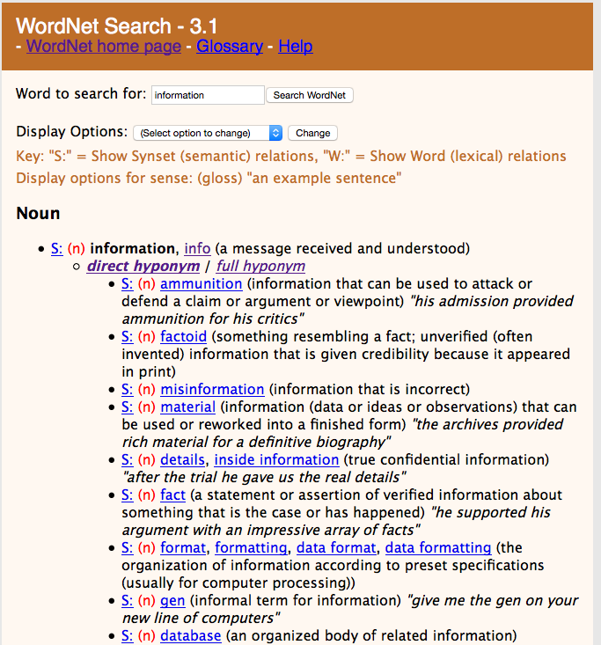
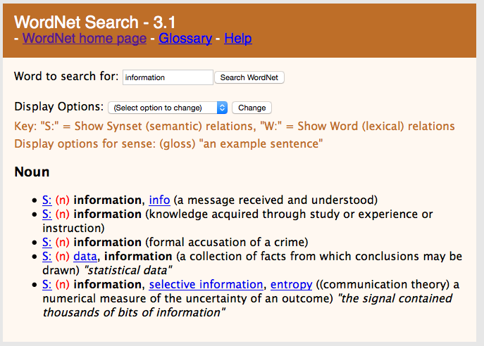
WordNet Example
http://wordnet.princeton.edu/

Slide 58
WikiData
Community project to create an open database of structured data
Data curation model like Wikipedia
Intended to support Wikipedia (InfoBoxes)
84 million entities (2020)
Multi-lingual
Both API access and full databases dumps (JSON, RDF)

Slide 59
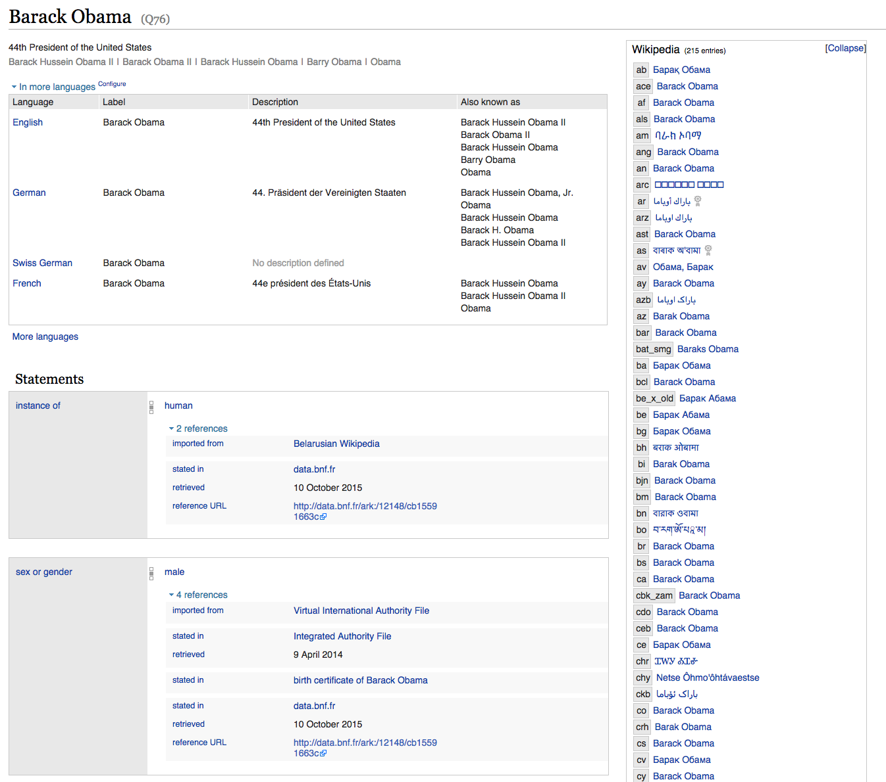
Example WikiData
www.wikidata.org

Slide 60
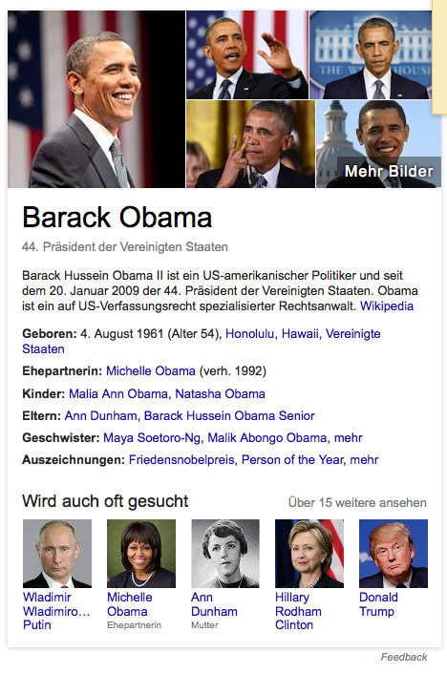
Google Knowledge Graph
Google’s internal knowledge base to support the search engine
Populated from FreeBase and internal data
Enriched with the support of schema.org
Accessible through API
https://www.google.com/intl/es419/insidesearch/features/search/knowledge.html

Slide 61
Schema.org
Collaborative, community activity to create, maintain, and promote schemas for structured data on the Internet
Sponsoring companies: Google, Microsoft, Yahoo and Yandex
Two type hierarchies: textual property values, things that they describe
Core vocabulary currently consists of 642 Types, 992 Properties, and 219 Enumeration values
Used by other knowledge bases, e.g. Google Knowledge Graph API, Dbpedia, etc.

Slide 62
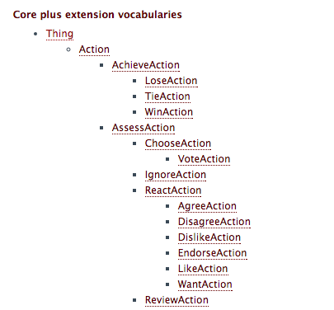
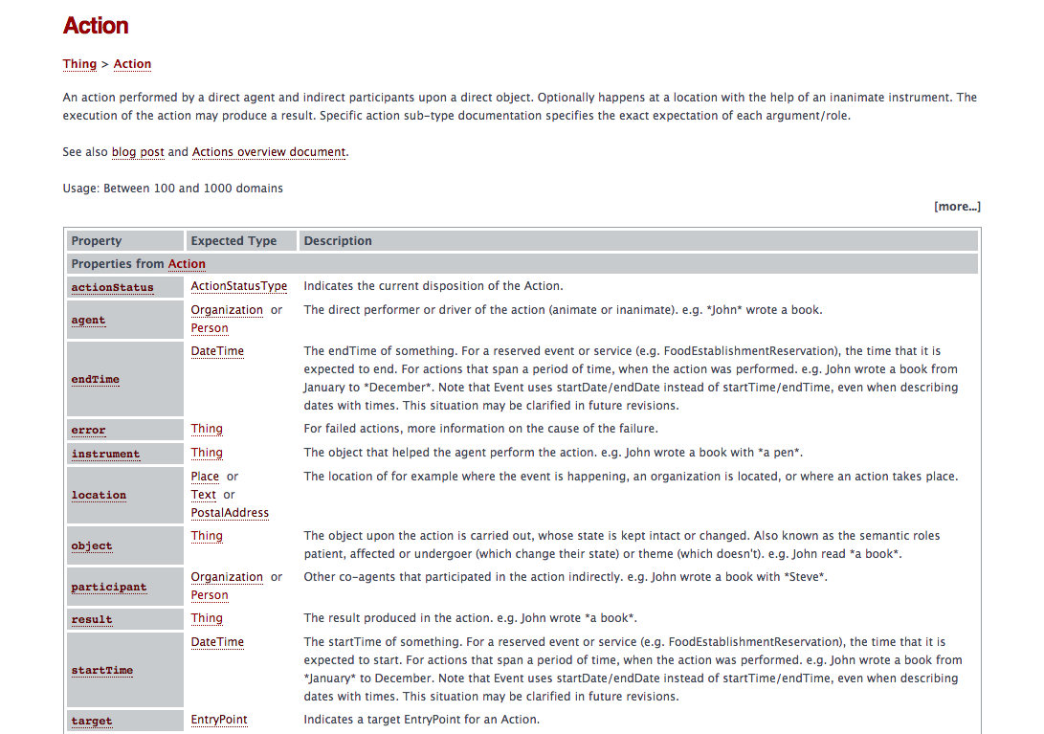
Example

Slide 63
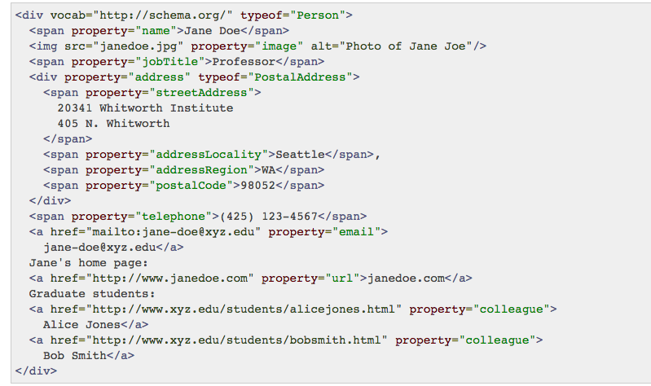
Encoding
Different encodings can be used, JSON, RDFa, Microdata
RDFa: microformat for embedding RDF into HTML

Slide 64
Linked Open Data
Repository of open data and knowledge bases and tools
https://www.w3.org/wiki/DataSetRDFDumps

Slide 65
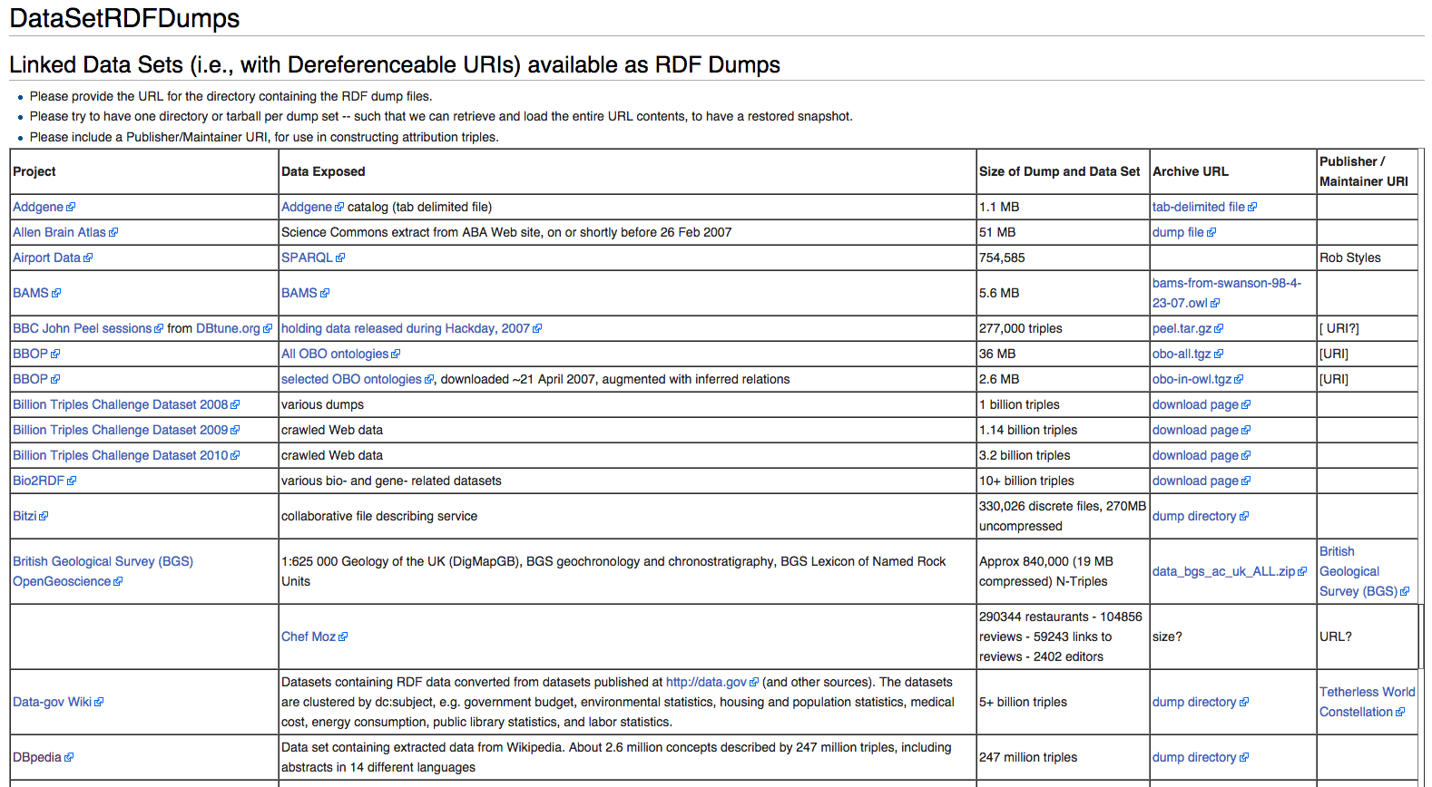
Linked Open Data Example

Slide 66
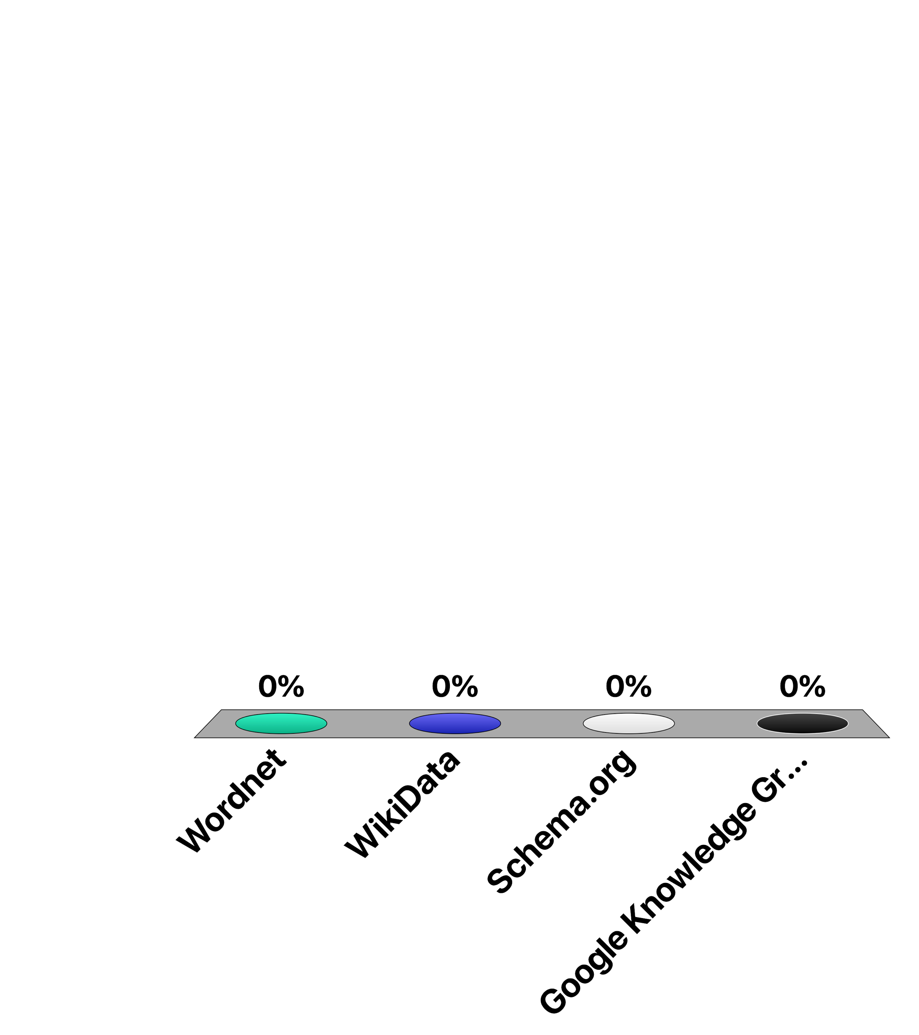
Which of the following is NOT an (instance-level) ontology?
Wordnet
WikiData
Schema.org
Google Knowledge Graph

Slide 67
References
Relevant articles
Grigoris Antoniou, Frank van Harmelen, Semantic Web Primer, MIT Press, 2nd edition, 2004.
Jeen Broekstra, Michel C. A. Klein, Stefan Decker, Dieter Fensel, Frank van Harmelen, Ian Horrocks: Enabling knowledge representation on the Web by extending RDF schema. WWW 2001: 467-478
Stefan Decker, Sergey Melnik, Frank van Harmelen, Dieter Fensel, Michel C. A. Klein, Jeen Broekstra, Michael Erdmann, Ian Horrocks: The Semantic Web: The Roles of XML and RDF. IEEE Internet Computing 4(5): 63-74 (2000)
WebSites
XML, XPath, Xquery, RDF: http://www.w3.org/
OWL: http://www.w3.org/TR/2004/REC-owl-features-20040210/#s1.1

